Slide 1
MICROPROCESSOR AND EMBEDDED SYSTEMS
CS3005-1
Course Type: IPCC Credits: 04
04/05/21

Slide 2
Course Objectives:
Outline the internal architecture of 8086 microprocessor, concept of addressing modes, instruction set and develop and execute basic programs.
Develop and execute modular assembly level language program for 8086 and must be able to write assembly level program for any processor by studying its architecture.
Understand the fundamentals of ARM embedded systems and analyze communication device components.
Apply embedded C programming for micro controller operations and to interface with peripherals.
Describe the hardware components of 8086 microprocessor, Construct machine code for 8086 instructions and Outlinethe concepts of interrupts.
04/05/21

Slide 3
UNIT-I
8086 INTERNAL ARCHITECTURE:
The Programming Model, Multipurpose registers, Special purpose Registers, Segment registers
8086 ADDRESSING MODES:
Register addressing, Immediate addressing, Direct addressing, Register Indirect addressing, Based addressing with displacement, Indexed addressing with dis-placement, Based Indexed addressing, Based Indexed addressing with displace-ment.
8086 ASSEMBLER DIRECTIVES:
ASSUME, DB, DW, DD, END, PROC, ENDP, SEGMENT, ENDS, EQU, IN-CLUDE, OFFSET, MACRO, ENDM.
8086 INSTRUCTIONS SET:
Data transfer instructions (including I/O transfers), Binary arithmetic instructions, Dec-imal arithmetic instructions (DAA and AAM only), Logical instructions, Shift and ro-tate instructions, Control transfer instructions.
8086 PROGRAMMING BASED ON INSTRUCTION SET:
Programs based on data transfer instructions, binary arithmetic instructions, logical instructions, shift and rotate instructions, control transfer instructions.
04/05/21

Slide 4
UNIT-II
MODULAR PROGRAMMING:
Using procedures, Using macros, Comparison between procedure and macro.
DATA CONVERSIONS:
ASCII to Hexadecimal, Hexadecimal to ASCII.
USING THE KEY BOARD AND VIDEO DISPLAY:
DOS and BIOS interrupts, Example Programs.
ARM Embedded Systems: RISC design philosophy, ARM design philosophy, Embedded system hardware, Embedded system software.
ARM processor fundamentals: Registers, Program Status Register, Pipeline.
Introduction to Embedded C Programming for Micro Controller operations: Arduino Due Micro controller board, Pinout Diagram, Features of Arduino Due board, Arduino IDE, Program Structure. Built in functions: pinMode(), Digital and Analog I/O operations, Delay, Serial Communication
Interfacing peripherals with micro controller: LED, Switches, Buzzer, Potentiometer, 16x2 LCD Display, Seven Seg-ment Display, Stepper Motor, 4x4 Keypad.
04/05/21

Slide 5
UNIT-III
8086 HARDWARE SPECIFICATIONS:
8086 memory addressing, 8086 pin functions (minimum mode, maximum mode and both minimum and maximum mode).
8086 INSTRUCTION FORMAT (MOV INSTRUCTIONONLY):
Generating machine code for register-to-register data transfer, memory/register to register/memory data transfer.
8086 INTERRUPTS: 8086 Interrupts and Interrupt responses, 8086 Interrupt types.
04/05/21

Slide 6
Suggested List of Experiments
Part-A
1. Searching
2. String manipulation
3. usage of Macros and subroutines
4. DOS interrupt usage
5. BIOS interrupt usage
Part-B
7. Interfacing LED/Buzzer on / off using Potentiometer and switches
8. Reading and displaying over serial monitor
9. Interfacing Stepper motor -Clockwise, anticlockwise, delay
10. Interfacing 16x2 LCD – scrolling and flickering
11. Interfacing Seven segment display
12. Interfacing 4x4 keypad
04/05/21

Slide 7
Course Outcomes:
1. Illustrate the internal architecture of 8086 microprocessor, concept of addressing modes. Develop and execute simple 8086 programs using 8086 instruction set.
2. Build and examine modular assembly level language program for 8086 microprocessors.
3. Describe the internal architecture of ARM processor and analyze schematics of communication devices.
4. Interface microcontroller to external I/O devices namely logic controller, stepper motor, seven segment display, DAC, keypad, and elevator.
5. Describe the hardware components of 8086 and Construct machine code for 8086 and understand interrupts.
04/05/21

Slide 8
TEXTBOOKS:
Barry B Brey, “The Intel Microprocessors”, 8th Edition, Pearson Education, 2009.
Douglas V Hall, “Microprocessors and Interfacing”, 2nd Edition, Tata McGraw-Hill Publication, 2006.
Andrew N. Sloss, Dominic Symes, Chris Wright, “ARM System Developer’s Guide Designing and Optimizing System Software”, Morgan Kaufmann Publisher,2004
Julien Bayle, “C Programming for Arduino”, Packt Publishing, 2013
REFERENCE BOOKS:
1. Liu &Gibson,“Microcomputer Systems: The 8086/8088 Family Architecture, Programming and Design”, PHI, 2006.
2. Muhammad Ali Mazidi, RolinMckinlay, Janice GillispieMazidi , Microcontroller And Embedded Systems Using Assembly And C, Pearson , 2007.
3. Muhammad Ali Mazidi, Rolin McKinlay, Danny Causey, PIC Microcontroller and Embedded Systems: Using assembly and C, Pearson, 2008.
E Books / MOOCs/ NPTEL
1. https://www.intel.com/content/www/us/en/products/processors/atom.html
2. https://en.wikipedia.org/wiki/Embedded_system
3. http://nptel.ac.in/courses/108107029/39
04/05/21

Slide 9
Why Microprocessors?
Core of Digital Systems:
Microprocessors are the "brain" of countless devices, from personal computers and smartphones to cars and industrial machines. Understanding how they work enables engineers to design and optimize such systems.
Hardware-Software Interaction:
Microprocessors bridge the gap between hardware and software. Learning about them gives you insight into how software commands are translated into physical actions in hardware.
Real-World Applications:
  Consumer Electronics: Microprocessors control devices like washing machines, smart TVs, and gaming consoles.
  Industrial Automation: Used in robotics, CNC machines, and sensors for precise operations.
  IoT and Embedded Systems: Microprocessors are integral to Internet of Things (IoT) devices, enabling connectivity and automation.
04/05/21

Slide 10
Problem-Solving Capability:
By understanding microprocessors, you learn to address practical challenges like resource constraints, power management, and efficient programming.
04/05/21

Slide 11
Why Assembly-Level Language?
Close to the Hardware:
Assembly language gives you direct control over the hardware, enabling you to understand the internal workings of the microprocessor. This low-level perspective is invaluable for debugging and optimization.
Efficiency:
  Speed: Assembly code executes faster because it is directly translated into machine language.
  Resource Utilization: You can optimize programs to make the best use of limited memory and processing power.
04/05/21

Slide 12
Foundation for Higher-Level Programming:
Learning assembly lays the groundwork for understanding higher-level languages like C, as well as concepts like pointers, memory allocation, and instruction execution.
Essential for Embedded Systems:
Embedded systems often operate under constraints (limited memory, processing power, and energy). Assembly programming ensures precise control and efficiency, which is crucial for such systems.
Debugging and Reverse Engineering:
Professionals use assembly language to:
  Debug at the hardware level.
  Reverse-engineer malware or legacy software.
04/05/21

Slide 13
Overview of Microcomputer Structure and Operation
04/05/21

Slide 14
Major parts are the CPU, Memory and the Input and Output circuitry or I/O
Connecting these parts are three sets of parallel lines called buses
Address bus, Data Bus and Control Bus
04/05/21

Slide 15
DATA BUS
INPUT
DEVICE
I/O
PORTS
CONTROL
BUS
CPU
CONTROL
BUS
MEMORY
(RAM AND
ROM)
OUTPUT
DEVICE
ADDRESS BUS
Block Diagram of a simple Microcomputer
04/05/21

Slide 16
Memory
Memory unit is the integral part of any microcomputer system and its primary purpose is to hold program and data
The major design goal of memory unit is to allow it to operate at a speed close to that of the processor
In order to seek a trade-off between the cost and operating speed, a memory system is usually designed with different technologies such as solid state, magnetic and optical
04/05/21

Slide 17
A Microcomputer memory can be logically divided into three groups:
  Processor Memory
  Primary or Main Memory
  Secondary memory
Processor Memory refers to a set of CPU registers
These registers are useful to hold temporary results when a computation is in progress
04/05/21

Slide 18
There is no speed disparity between the registers and the microprocessor because they are fabricated using the same technology
The main disadvantage is the cost involved which forces the architect to include very few registers (usually 8 to 16 only) in the microprocessor
04/05/21

Slide 19
Primary Memory:
Is the storage area in which all the programs are executed
The processor can directly access only those items that are stored in the primary memory
All the programs and corresponding data must be within primary memory prior to execution
The size of primary memory is much larger compared to processor memory but its operating speed is slower than processor registers
04/05/21

Slide 20
Primary memory normally includes ROM (Read Only Memory) and RAM (Random Access Memory)
04/05/21

Slide 21
Secondary memory
Refers to the storage medium for huge files such as program source codes, compilers, operating systems, RDBMSs etc
These are not needed very frequently
They comprises of slow devices such as magnetic tapes and optical disks
04/05/21

Slide 22
Input/Output
Allows the computer to take in data from the outside world or send data to the outside world
Peripherals such as keyboards, video display terminals, printers and modems are connected to the I/O section
The actual physical devices used to interface the computer buses to external systems are called ports
04/05/21

Slide 23
An input port allows data from a keyboard, an A/D converter, or some other source to be read into the computer under the control of CPU
An output port is used to send data from the computer to some peripheral, such as a video display terminal, a printer etc
04/05/21

Slide 24
Central Processing Unit (CPU)
Controls the operation of the computer
Fetches binary-coded instructions from memory, decodes the instructions into a series of simple actions and carries out these actions in a sequence of steps
Also contains Address Counter or Instruction Pointer register
04/05/21

Slide 25
Address Bus
Consists of 16, 20, 24 or 32 parallel signal lines
On these lines the CPU sends out the address of the memory location that is to be written or read from
The number of unique addresses a microprocessor can generate depends on the width of this bus
04/05/21

Slide 26
16 – bits address bus - it can generate 2¹⁶ = 65,536 different addresses
Unidirectional – from microprocessor to memory or I/O elements
04/05/21

Slide 27
Data Bus
Consists of 8, 16 or 32 parallel signal lines
Bidirectional – data is brought on these lines prior to an operation and results are sent back to selected memory location or I/O using these lines only
The width determines the amount of information that can be brought/sent at once, more precisely in one machine cycle into or out of processor
04/05/21

Slide 28
Control Bus
Consists of 4 to 10 signal lines
CPU sends out signals on the control bus to enable the outputs of addressed memory devices or port devices
Typical control bus signals are Memory Read, Memory Write, I/O Read, and I/O Write
Some signals are unidirectional and some are bidirectional
04/05/21

Slide 29
The memory read signal enables the addressed memory device to output a data word onto the data bus
The data word from the memory travels along the data bus to the CPU
04/05/21

Slide 30
Hardware, Software, and Firmware
Hardware is the name given to the physical devices and circuitry of the computer
Software refers to the programs written for the computer
Firmware is the term given to programs stored in ROMs or in other devices which permanently keep their stored information
04/05/21

Slide 31
EVOLUTION
OF
MICROPROCESSORS
04/05/21

Slide 32
First generation (1971 – 73)
Intel Corporation introduced 4004, the first microprocessor in 1971. It is evolved from the development effort while designing a calculator chip
There were three other microprocessors in the market during the same period:
  Rockwell International’s PPS-4 (4 bits)
  Intel’s 8008 (8 bits)
  National Semiconductor’s IMP-16 (16 bits)
04/05/21

Slide 33
They were fabricated using PMOS technology which provided low cost, slow speed and low output currents
They were not compatible with TTL
04/05/21

Slide 34
Second Generation (1974 – 1978)
Marked the beginning of very efficient 8 – bit microprocessors
Some of the popular processors were:
  Motorola’s 6800 and 6809
  Intel’s 8085
  Zilog’s Z80
They were manufactured using NMOS technology
This technology offered faster speed and higher density than PMOS
It is TTL compatible
04/05/21

Slide 35
Third generation microprocessors (1979 – 80)
This age is dominated by 16 – bits microprocessors
Some of them were:
  Intel’s 8086/80186/80286
  Motorolla’s 68000/68010
They were designed using HMOS technology
HMOS provides some advantages over NMOS as
Speed-power-product of HMOS is four times better than that of NMOS
HMOS can accommodate twice the circuit density compared to NMOS
04/05/21

Slide 36
Fourth Generation (1981 – 1995)
This era marked the beginning of 32 bits microprocessors
Intel introduced 432, which was bit problematic
Then a clean 80386 in launched
Motorola introduced 68020/68030.
They were fabricated using low-power version of the HMOS technology called HCMOS
04/05/21

Slide 37
Fifth Generation (1995 – till date)
This age the emphasis is on introducing chips that carry on-chip functionalities and improvements in the speed of memory and I/O devices along with introduction of 64-bit microprocessors.
04/05/21

Slide 38
Architecture of 8086
04/05/21

Slide 39
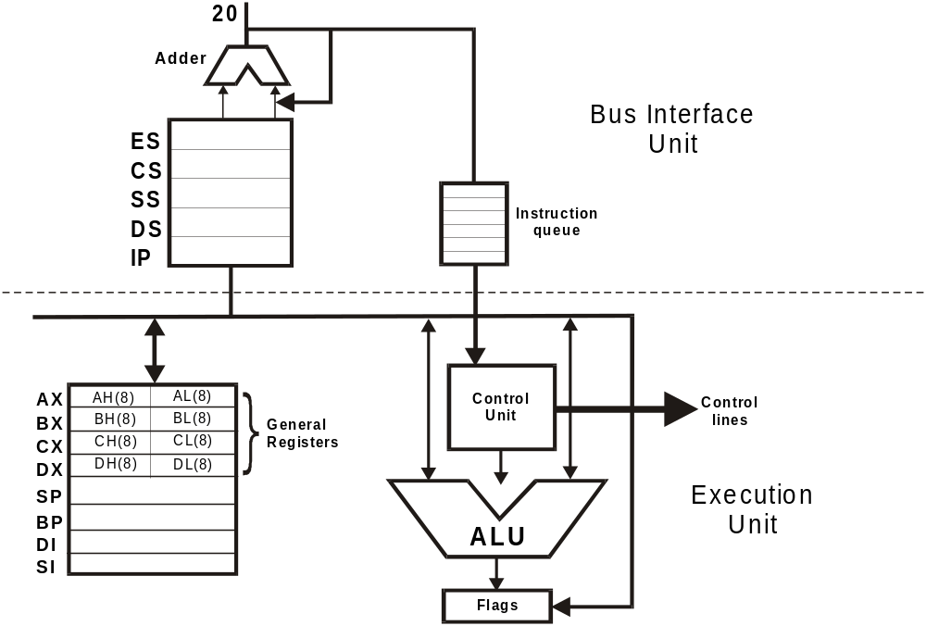
04/05/21

Slide 40
Execution Unit
The execution unit consists of
  Arithmetic Logic Unit
  Control unit
  Flag Registers
  General Registers
04/05/21

Slide 41
Arithmetic Logic Unit (ALU)
ALU is 16-bits wide. It can do the following 16-bits arithmetic operations
    Addition
    Subtraction
    Multiplication
    Division
Arithmetic operations may be performed on four types of numbers
    Unsigned binary numbers
    Signed binary numbers (Integers)
    Unsigned packed decimal numbers
    Unsigned unpacked decimal numbers
04/05/21

Slide 42
The ALU can also perform logical operations such as
    NOT
    AND
    OR
    EXCLUSIVE OR
    TEST
04/05/21

Slide 43
Flag Register
The Execution Unit has a 16-bit flag register which indicates some conditions affected by the execution of an instruction
Some bits of the flag register control certain operations of the EU
04/05/21

Slide 44
15 | 14 | 13 | 12 | 11 | 10 | 9 | 8 | 7 | 6 | 5 | 4 | 3 | 2 | 1 | 0
U | U | U | U | OF | DF | IF | TF | SF | ZF | U | AF | U | PF | U | CF
04/05/21

Slide 45
Six of the nine flags are used to indicate some condition produced by an instruction
These condition flags are also called status flags of 8086 microprocessor
These are the Carry flag, Parity flag, Auxiliary carry flag, Zero flag, and Sign flag
The other three Control flags are Trap Flag, Direction Flag and Interrupt flag
04/05/21

Slide 46
Carry Flag (CF)
This flag will be set to one if the addition of two 16-bit binary numbers produces a carry out of the most significant bit position or if there is a borrow to the MSB after subtraction
This flag is also affected when other arithmetic and logical instruction are executed
04/05/21

Slide 47
Parity Flag (PF)
This flag is set, if the result of the operation has an even number of 1's (in the lower 8 bits of the result)
This flag can be used to check for data transmission error
04/05/21

Slide 48
Auxiliary Carry Flag (AF)
This flag is set, when there is a carry out of the lower nibble to the higher nibble or a borrow from the higher nibble to the lower
The auxiliary carry flag is used for decimal adjust operation
04/05/21

Slide 49
Zero Flag (Z)
This flag is set when the result of an operation is zero
The flag is reset when the result is not zero
04/05/21

Slide 50
Overflow Flag (O)
This flag is set, when an arithmetic overflow occurs
Overflow means that the size of the result exceeded the storage capacity of the destination, and a significant digit has been lost
04/05/21

Slide 51
Sign flag (S)
This flag is set, when an MSB bit of the result is high after an arithmetic operation
When this flag is set the data is assumed to be negative and when this flag is zero it is assumed to be positive
04/05/21

Slide 52
Control Flags
Control flags are used to control certain operations of the processor
The application of these flags are different from that of six conditional flags
The conditional flags are set or reset by the EU on the basis of the result of some arithmetic or logic operations
The control flags are deliberately set or reset with specific instructions included in the program
04/05/21

Slide 53
Trap flag (T)
This is used for single stepping through a program
It is used for debugging the programs
04/05/21

Slide 54
Interrupt Flag (I)
It is used to allow / prohibit the interruption of a program
When the flag set, it enables the interrupt from INTR
When the flag is reset (0), it disables the interrupt
04/05/21

Slide 55
Direction Flag (D)
It is used for string instruction
If the direction flag is set, the pointers are decremented else the pointers are incremented
String array1 array2
04/05/21

Slide 56
General Registers
The CPU has eight 16-bit general registers
They are divided into two files of four registers each
They are:
(a) The data register file and
(b) The pointer and index register file
04/05/21

Slide 57
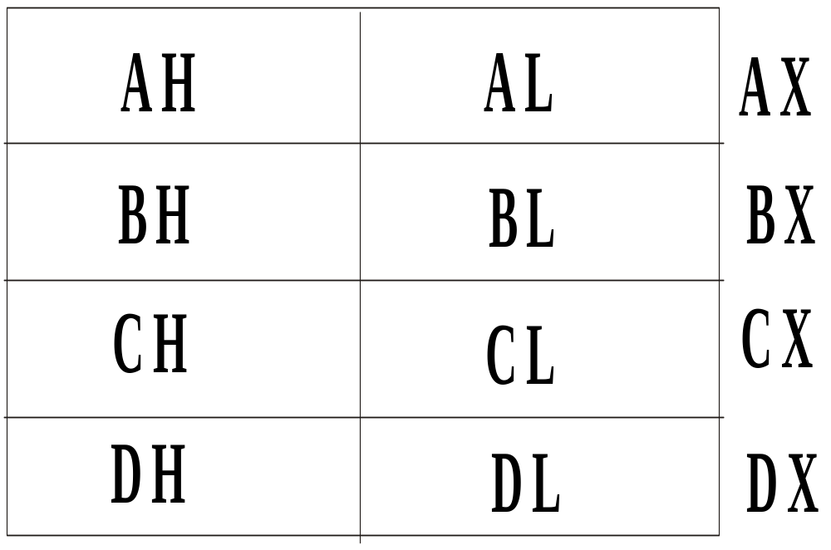
Data Register File
04/05/21

Slide 58
The upper and lower halves of the data registers are individually addressable
The data registers can be used in most arithmetic and logic operations
Some instructions however require these registers for specific use
04/05/21

Slide 59
The index register file consists of the Stack Pointer (SP), the Base Pointer (BP), Source Index (SI) and Destination Index (DI) registers all are of 16-bits
These registers are usually used to hold offset addresses for addressing within a segment
Offset addressing reduces program size by eliminating the need for each instruction to specify frequently used addresses
04/05/21

Slide 60
Stack pointer:it holds the 16 bit offset from the start of stack segment to the memory location where a word most recently stored on a stack(top of the stack).
04/05/21

Slide 61
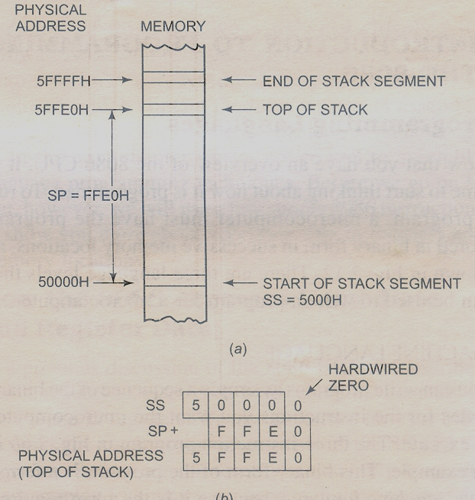
04/05/21

Slide 62
The pointer and index register files are further divided into the pointer sub-file (containing the Stack Pointer and the Base Pointer registers) and the index sub-file (containing the Source index and Destination index registers)
Unless otherwise specified in the instruction, stack pointer registers refer to the current stack segment while index register refers to the current data segment
04/05/21

Slide 63
8086 has an additional pointer into the stack called the BP register
the BP register is used to hold an old stack pointer value, or it can mark a place in the subroutine stack independent of the SP register
SI and DI are both 16-bits wide and are used by string manipulation instructions and in building some of the more powerful 8086/8088 data structures and addressing modes
04/05/21

Slide 64
Both the SI and the DI registers have auto incrementing and auto-decrementing capabilities
04/05/21

Slide 65
Bus Interface Unit (BIU)
The BIU sends out addresses, fetches instructions from memory, reads data from memory and ports, and writes data to ports and memory
BIU handles all transfers of data and addresses on the buses for the execution unit
The BIU has
1. An instruction queue
2. An Instruction pointer
3. Segment registers
04/05/21

Slide 66
Instruction Queue
To speed up program execution, the BIU fetches as many as 6 instruction bytes ahead of time from memory
The prefetched instruction bytes are held for the EU in a first-in-first-out group of register called a queue
When the EU is ready for its next instruction, it simply reads the instruction from the queue in the BIU
04/05/21

Slide 67
Fetching the next instruction while the current instruction executes, is called pipelining
04/05/21

Slide 68
Segment Registers
The 8086 microprocessor has 20-bit address lines
All the segment registers in 8086 are 16-bits in length
A segment is a logical unit of memory that may be up to 64K bytes long
04/05/21

Slide 69
Each segment is made up of contiguous memory locations and is an independent, separately addressable unit
Each segment is assigned a base address, which is its starting location in the memory space
All segments start on 16-bit memory boundaries
04/05/21

Slide 70
A segment register is used to hold the upper 16 bits of the starting address for each of the segments
The BIU always inserts zeros for the lowest 4 bits (nibble) of the 20-bit starting address for a segment
If the code segment register contains 348Ah, then the code segment will start at address 348A0h
04/05/21

Slide 71
FFFFFH
HIGHEST ADDRESS
7FFFFH
Top of Extra Segment
64k
70000H
Extra Segment Base ES = 7000H
5FFFFH
Top of Stack Segment
64k
50000H
Stack Segment Base SS = 5000h
4489FH
Top of Code Segment
64k
348A0H
Code Segment Base CS = 348Ah
2FFFFH
Top of Data Segment
64k
20000H
Bottom of Data Segment
04/05/21

Slide 72
Given that the EA is 2359 H and the DS = 490B H, what is the physical address?
DS: 490B0 H
EA: 2359 H
Physical add. 4B409
04/05/21

Slide 73
Instruction Pointer (IP)
The Instruction Pointer is a 16-bit register
The instruction pointer is incremented after each opcode fetch to point to the next instruction
The value contained in the IP is referred to as an offset because this value must be offset from (added to) the segment base address in CS to produce the required 20-bit physical address sent out by the BIU
04/05/21

Slide 74
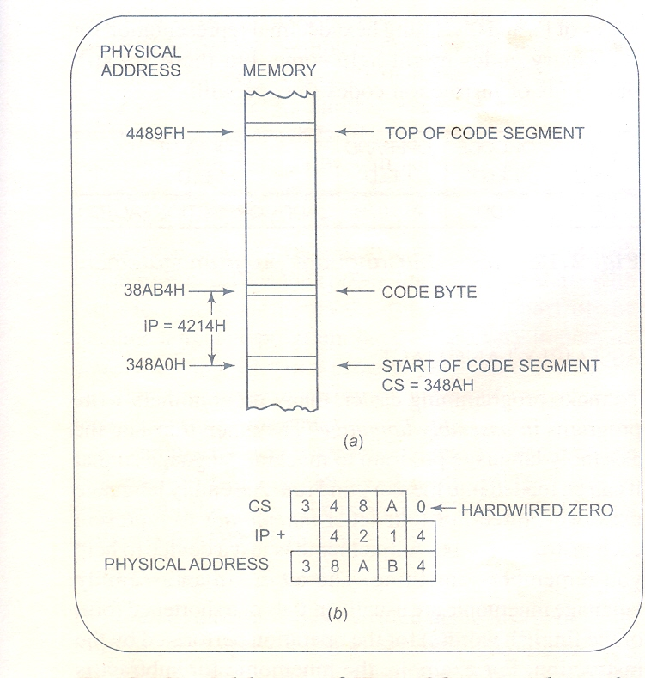
04/05/21

Slide 75
Thank You..
04/05/21

